Slide 1


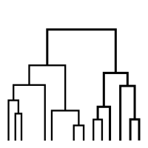
Kfir Gaon Roman Ratchitski
Students:
Lecturer:
Dr. Dan Lemberg
Hierarchical clustering (Agglomerative)
Students:
Kfir Gaon Roman Ratchitski
Lecturer:
Dr. Dan Lemberg
Date:
January 18, 2021
1

Slide 2
Table Of Contents
1
Algorithm
Types of Linkages, How it works
2
Pseudocode Algorithm (for single linkage)
single linkage, Optimization
3
Code Optimization
C++, Python
4
Pros And Cons
C++, Python
5
Runtime Comparison
C++, Python After Optimization
2

Slide 3
Algorithm
3

Slide 4
The purpose of the algorithm
In data mining and statistics, hierarchical clustering (also called hierarchical cluster analysis or HCA) is a method of cluster analysis which seeks to build a hierarchy of clusters. trategies for hierarchical clustering generally fall into two types:
Agglomerative: This is a "bottom-up" approach: each observation starts in its own cluster, and pairs of clusters are merged as one moves up the hierarchy.
Divisive: This is a "top-down" approach: all observations start in one cluster, and splits are performed recursively as one moves down the hierarchy.
For example: division of customers in the restaurant, according to the areas of interest in the restaurant, thus allowing the publication of information relevant to the same group of people the food they like.
4

Slide 5
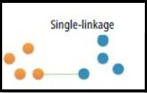
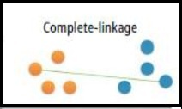
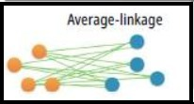
Algorithm - Types of Linkages
We require to find the among the clusters. This is done by calculating the distance between the clusters. There are multiple ways of calculating the distance such as Single Linkage, Complete Linkage and Average Linkage
Single - Linkage Clustering: Minimum distance between clusters.
Complete - Linkage Clustering: Maximum distance between clusters.
Average - Linkage Clustering: Average distance between clusters.
Single Linkage (Nearest neighbour)
Complete Linkage (Farthest neighbour)
Average Linkage
4

Slide 6
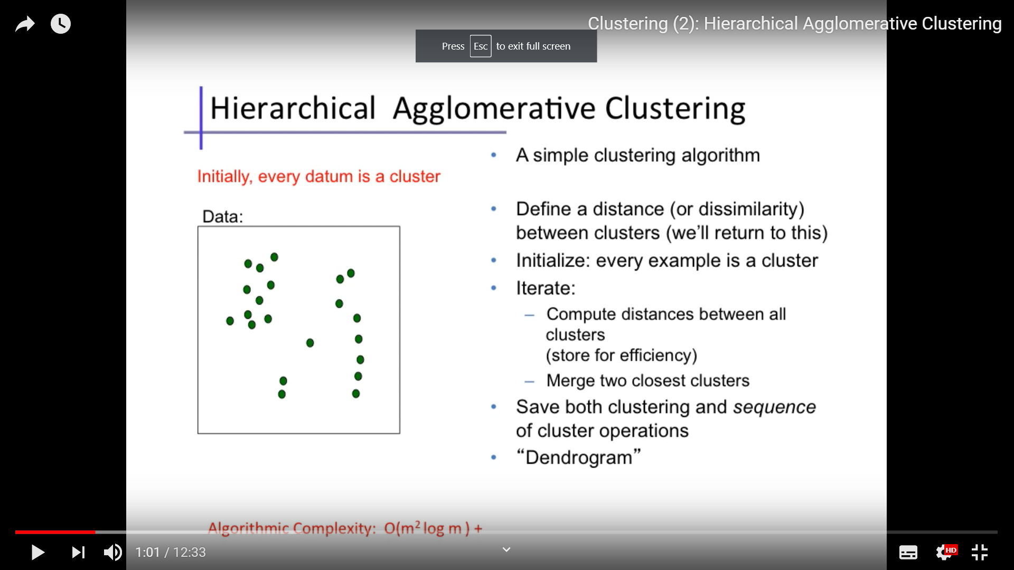
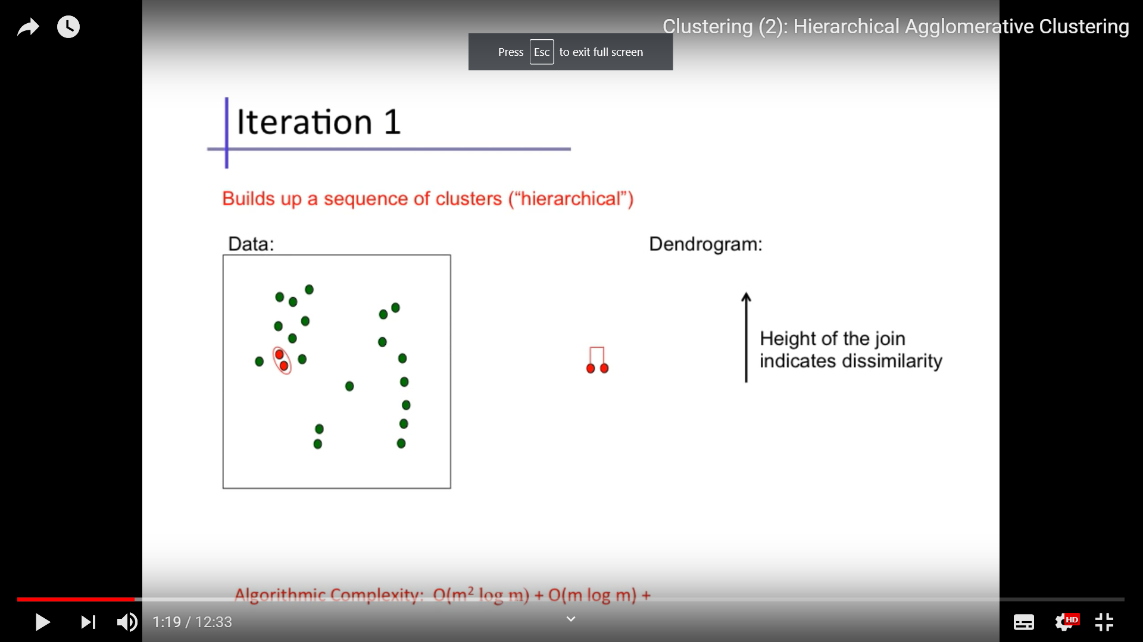

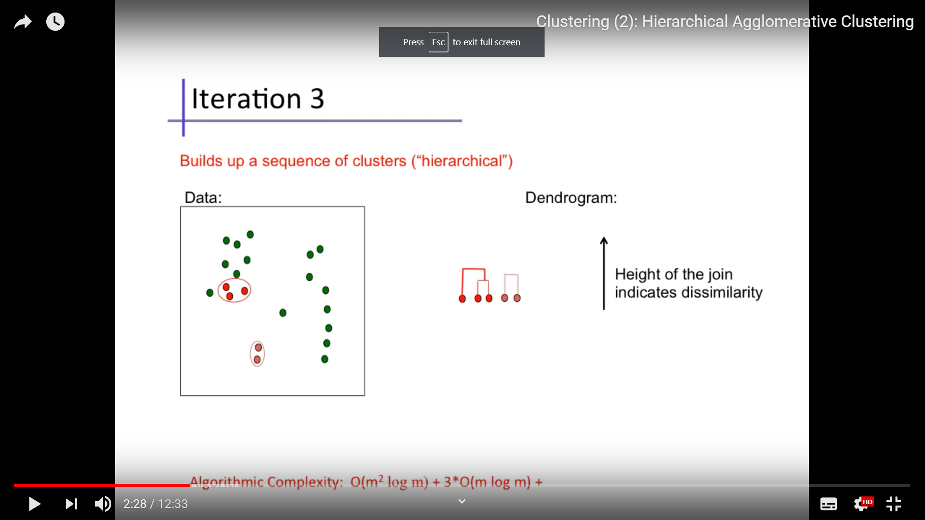
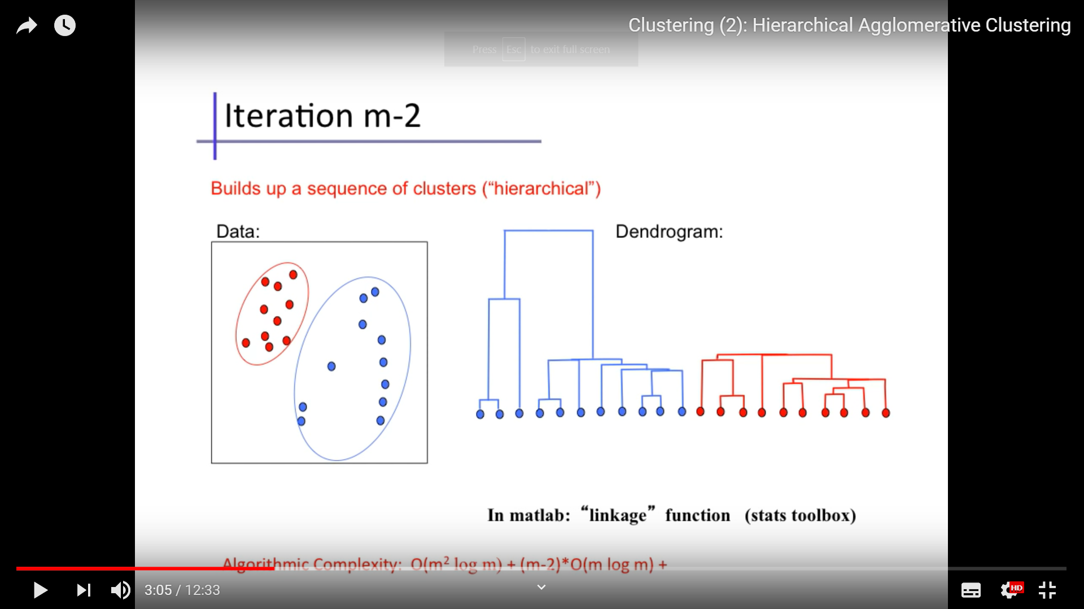
Algorithm
k = 2,
num_current_clusters = 21
k = 2,
num_current_clusters = 20
k = 2,
num_current_clusters = 19
k = 2,
num_current_clusters = 18
Final result:
k = 2,
num_current_clusters = 2
…
4

Slide 7
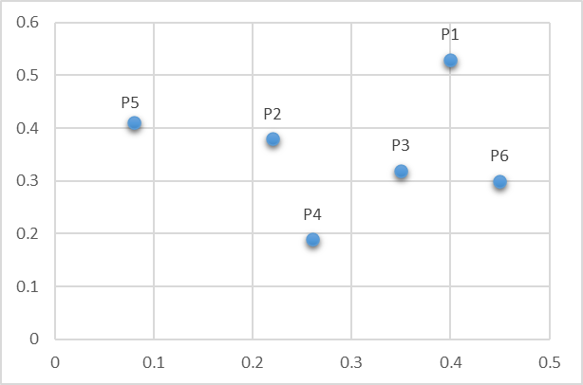
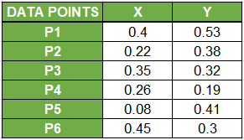
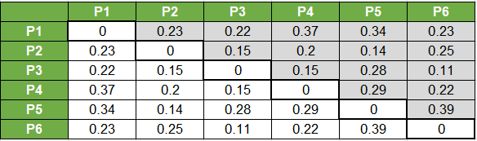
How It Works
Input: NxN matrix (distance matrix), n_clusters (number of clusters)
Output: Vector that represents each point its classification
4

Slide 8
How It Works
Input: NxN matrix (distance matrix), n_clusters (number of clusters)
Output: Vector that represents each point its classification
Input = distance_Matrix, n_clusters = 2
4

Slide 9
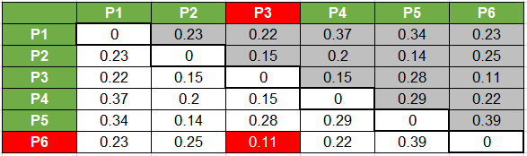
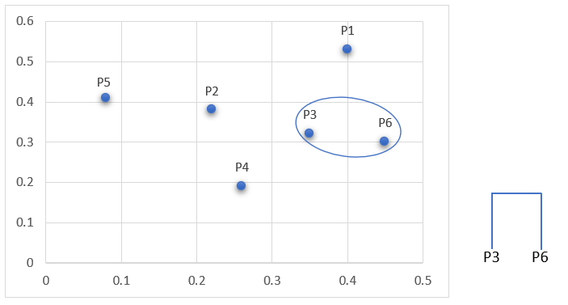
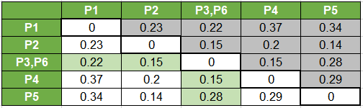
How It Works – Step 1
4

Slide 10
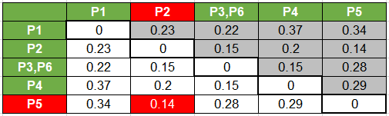
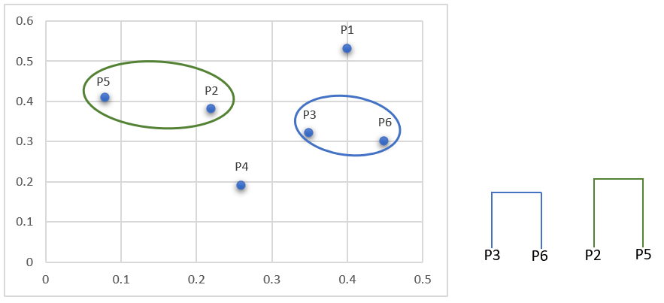
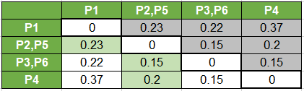
How It Works – Step 2
4

Slide 11
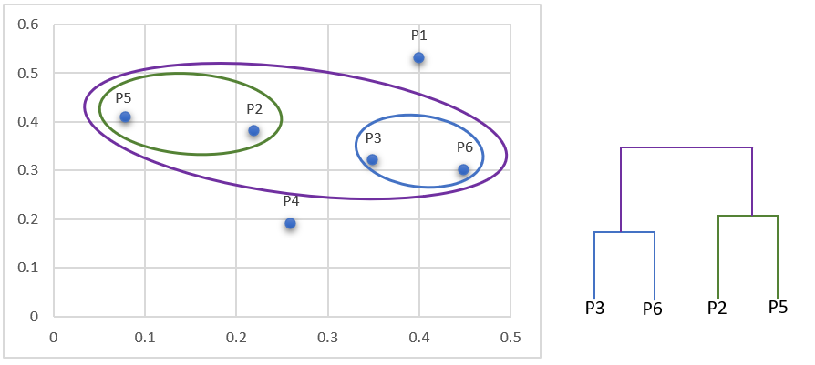
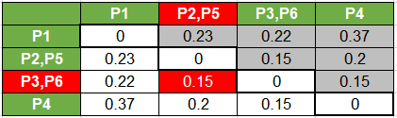
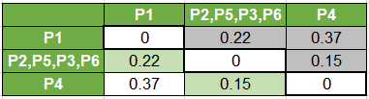
How It Works – Step 3
4

Slide 12
Pseudocode Algorithm (for single linkage)
HCA(dist_mtx[N][N] , n_clusters)
Initialize: result = each point is a cluster // [[0], [1], [2], [3]…..[N]]
(number_of_clusters = N)
While (number_of_clusters > n_clusters)
Find 2 closest clusters from distance matrix
For each distance of point(row)
For each distance of point(column) of row
If (point(column) == Diagnal) -> continue;
Update if smaller than the current minimal distance
Update matrix with minimum of the two columns (and rows), only one column/row represents the new cluster
Update result
4

Slide 13
Pseudocode Algorithm After Optimization (for single linkage)
HCA(dist_mtx[N][N] , n_clusters)
Initialize: result = each point is a cluster // [[0], [1], [2], [3]…..[N]]
(number_of_clusters = N)
nearest_array = number of columns at distance matrix // each index at this array represent the minimum
value of the each column.
While (number_of_clusters > n_clusters)
Find 2 closest clusters from nearest_array
Update distance matrix
Updaate nearest_array
Update result
4

Slide 14
Running Time
 | Our implementaion | System implementaion
CPP | 7.3114644 [Sec] | 1.3549842 [Sec]
Python | [Sec]12.8296456 | 4.4984834 [Sec]
4

Slide 15
Code Optimization
C++
Use runtime-reducing functions, such as Transfrom, and the Vector library and reserve for a list.
Python
NumPy library!
4

Slide 16
pros and cons
C++
PROS
Dynamic allocation
OOP
CONS
No garbage collector
Less readable code
Python
PROS
Many efficient libraries (built in code optimization)
Much less code
CONS
No dynamic allocations
4

Slide 17
THANK YOU
31

